Slide 1
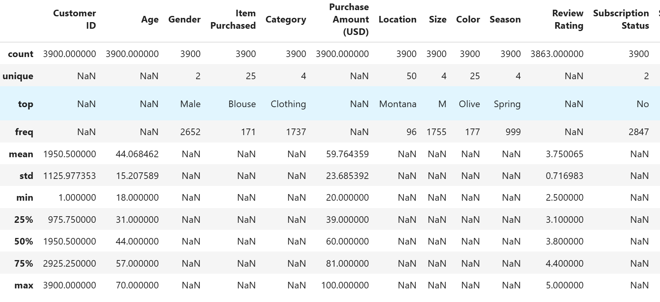
Customer Shopping Behavior Analysis
1.Project Overview :
This project analyzes customer shopping behavior using transactional data from 3,900 purchases
across various product categories. The goal is to uncover insights into spending patterns,,customer,
segements,products preferences,and subscription behavior to guide strategic business decisions.
2.Dataset Summury :
- Rows : 3900
-Columns: 18
- Key Features:
- Customer demographics (Age,Gender,Location,Subscription Status)
- Purchases details(item Purchased, Category, Purchase Amount, Season, Size,Color)
- Shopping Behavior (Discount Applied, Promo code, Previous Purchases,Frequency of
Purchases, Preview Rating , Shipping Type)
- Missing Data : 37 values in Review Rating column
3.Exploratory Data Analysis using Python
  Data Loading: Imported dataset using pandas.
  Initial Exploraion: Used df.info() to check structure and .describe() fro summury
  statistics.

Slide 2
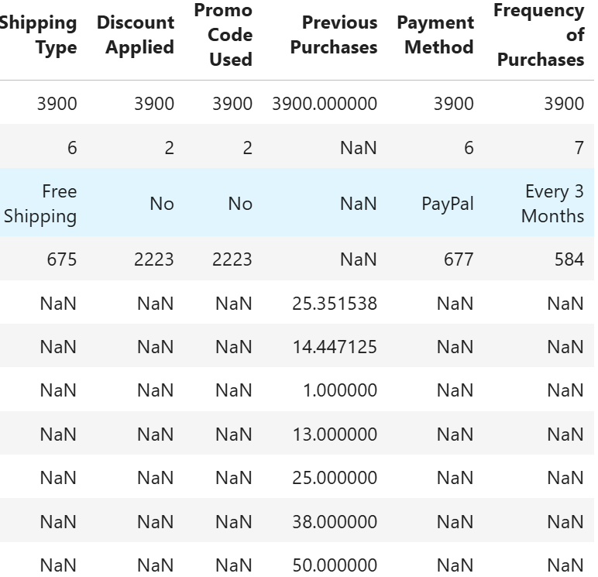
Missing Data Handling : Checked for null values and imputed missing values in the Review Rating column using the median rating or each product Category.
Column Standardization : Renamed columns to snake case for better readability and documantion
Feature Engineering:
  Created age_group column by binning customer ages.
  Created Purchase_frequency_days from purchase data.
4. Data Analysis using SQL (Business Transactions)
Performed structured analysis in MySQL to answer key business questions
1. Revenue by Gender – Compared total revenue generated by male vs. female
customers

Slide 3

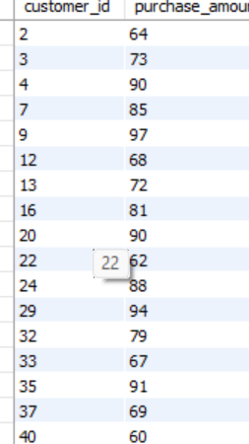
2. High-Spending Discount Users – Identified customers who used discounts but still spent above the average purchase amount
3. Top 5 Products by Rating : Found products with the highest average review rating s

Slide 4
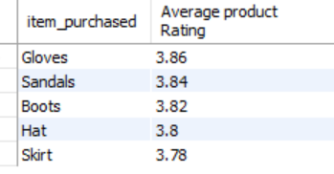


4. Shipping Type Comparison – Compared average purchase between
amounts between Standard and Express shipping
5. Subscribers vs. Non-Subscribers – Compared average spend and total revenue across subscription status.
6. Discount-Dependent Products – Identified 5 products with the highest percentage of discounted purchases.

Slide 5
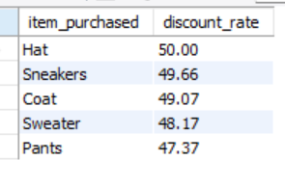
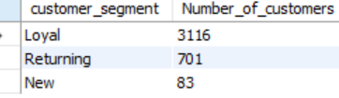
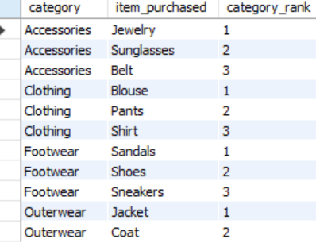
7. Customer Segmentation - Classified customers into New, Returning , and Loyal segments based on purchase history
8. Top 3 Products per Category - Listed the most purchased products within each category.

Slide 6

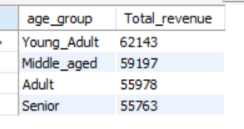
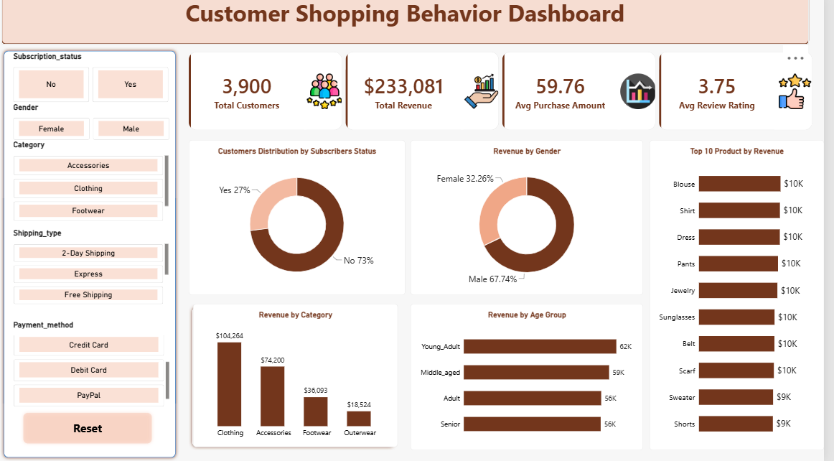
9. Repeat Buyers & Subscriptions – Checked whether customers with >5 purchases are more likely to subscribe.
10. Revenue by Age Group – Calculated total revenue contribution of each age group
Dashboard in Power BI
Finally Built an Interactive Dashboard in Power Bi

Slide 7
6. Business Recommendations:
  Grow Subscriptions – Test clear member benefits, such as exclusive offers or early access and track subscription rate, repeat purchases, and revenue per customer
  Strengthen Customer Loyalty - Use the New , Returning and Loyal segments to tailor follow – ups and rewards monitor repeat – purchase rate and time between purchases.
  Optimize Discount Strategy - Identify products frequently bought with discounts, then compare sales and profit to avoid unnecessary markdowns.
  Improve Product Positioning - Promote products that combine strong sales with high ratings and investigate lower – rated products before increasing promotions.
  Refine Targeted Marketing – Use age_group ,Category , and gender views to design campaign tests compare conversion , average order value and profit before Shifting bugget.

